Slide 1
Striving to Thriving
Core Concepts in a Modular Deck
Build Your Own Presentation
Notes:
“Anthony” by Kalaia Petteway, Grade 12
CHARM: Voices of Baltimore Youth, charmlitmag.org

Slide 2
About this slide deck
ABOUT
The following slides highlight the core concepts of Striving to Thriving, a research project of Equitable Futures.
You can use this deck to learn more about these core concepts and you can also incorporate — with attribution — slides from each module into your own conversations or presentations.
We hope that this deck and the Striving to Thriving research can support your work to improve young people’s lives and career choices.
Cover Illustration, “Anthony” by Kalaia Petteway, Grade 12
CHARM: Voices of Baltimore Youth, charmlitmag.org

Slide 3
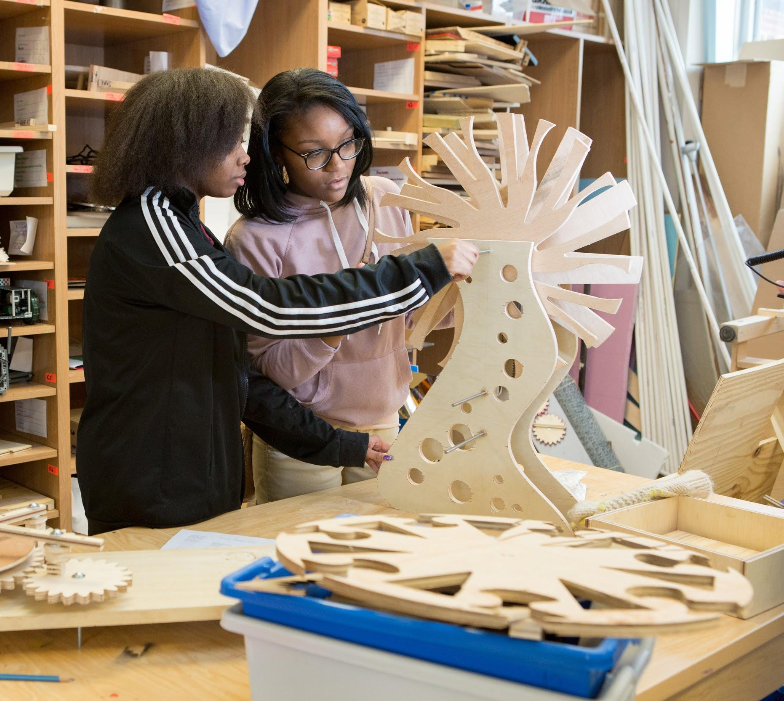
META CONCEPT
What if young people’s experiences and perspectives are a critical and missing dimension to efforts to improve career pathways for young people?
When it comes to designing interventions that support career pathways, young people’s own ideas, experiences, perspectives, and unique intelligences are often undervalued or ignored—even more so when the voices belong to Black and Hispanic young people and young people from households with lower incomes.
Illustration by August Smith, age group 18-21

Slide 4
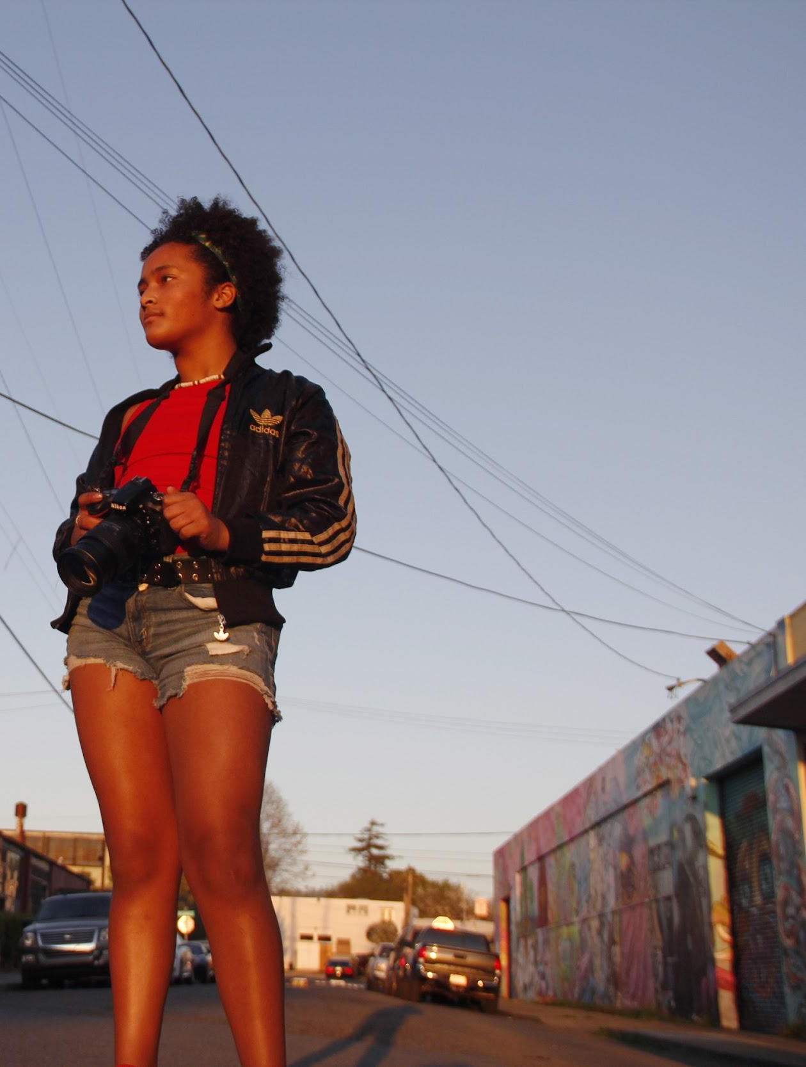
Core Concepts
7 CONCEPTS
How young people see themselves:
I can change my life
My identity will help me succeed
I want to have a good life, and a good job is key
I know I might need support, but I’m not sure how to get it
I am already on a pathway to my future
Frameworks:
Language Matters: Intentional Relationships
Language Matters: Job, Work and Career
Photograph by Annabelle Armstrong-Temple, age 12
4

Slide 5
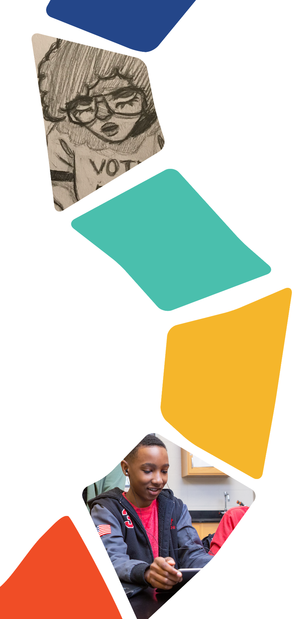
I can change my life
CHANGE
CORE CONCEPT #1
Black and Hispanic young people and young people from households with lower incomes see themselves as the most important change agents in their own lives. Young people are optimistic, capable, and resourceful and they value career exploration, while parents expect a linear pathway.
Illustration by Lonnie Allen, Age 17

Slide 6
Core Concept #1: In their own words
CHANGE
“I don't like the pressure. I think that is why I didn't go to college right after graduating because I had no idea what I wanted to do, and I didn't like being pressured by the school system and my parents and everyone that as soon as I graduated I have to know what I want to do the rest of my life. I have to know what school I'm going to go to. I have to have all of that planned out right when I graduate and I was like no, too much pressure. I’d rather just let some time go, figure out what I want to do, and then go into it wholeheartedly without having it shoved down my throat, ‘this is what you have to do.’”
–PUEBLO, CO, WHITE FEMALE, 17-21, LOWER INCOME

Slide 7
Core Concept #1: In their own words
CHANGE
“So, the first college degree I’m going for is the HVAC program, the heating and ventilation. And then I’m going to go back and get my automotive one because I like working on cars.”
–YAKIMA, WA, HISPANIC MALE, 16-21, LOWER INCOME
“Because, like, I know New Orleans got a lot of Black businesses. They got a lot of Black clothing lines. I see that motivates me. It’s just a bunch of, that’s a positive, like just starting to bring people like...someone said something earlier about like Black people starting to elevate.”
–NEW ORLEANS, LA, BLACK MALE, 17-21, LOWER INCOME

Slide 8
Core Concept #1: In their own words
CHANGE
“As a nurse...I’m still helping people, and I can work wherever I want. I have the option to change whenever I want to. I don’t have to just be in labor and delivery. I could be in oncology. I don’t have to stay in one place. And that’s really what appealed to me.”
–BALTIMORE, MD, BLACK FEMALE, 17-20, HIGHER INCOME

Slide 9
I can change my life
CHANGE
ADDITIONAL TALKING POINTS
Adults in young people’s lives may express feelings that their optimism and expectations are unrealistic.
The optimism young people express about their futures can serve as an opportunity for adults to both support them and help them develop pragmatism to achieve their goals.
Young people’s decisions are informed by the cultural, structural, and emotional environments in which they live, study, and grow (e.g., concern about education-related debt).

Slide 10
My identity will help me succeed
CONCEPT #2
IDENTITY
CORE CONCEPT #2
Within a personal, familial, and community context, young people believe that their personal identities are largely an asset and will be beneficial to their success in life. While young people aim to thrive, how they imagine getting there is deeply informed by their individual identities and sense of self. Many Black and Hispanic young people in particular, feel their race, ethnicity and culture will benefit them as they pursue their life goals. While many young people anticipate experiencing some form of discrimination, they believe they can overcome this by doing and being better.
Illustration by Lonnie Allen, Age 17

Slide 11
Core Concept #2: In their own words
IDENTITY
IDENTITY
“[Black people] are the strongest folks on earth.”
–ATLANTA, GA, BLACK MALE 18-21, LOWER INCOME
“Yes, my gender is especially important to me because I take a lot of time perfecting my girly look every single day. It's what drives me and gives me my confidence. Also the ability to stay strong as a woman figure today and just being happy with what I was born with. Culture is definitely important to me when it comes to food because that’s all I mainly consume is Spanish food especially on my days off. Religion is important to me and I choose to believe in my own way. Race is important as well because that’s where my ancestors are from and what we have to remember today about our common past.”
–ONLINE, HISPANIC FEMALE, 26-29, MIXED INCOME

Slide 12
Core Concept #2: In their own words
IDENTITY
IDENTITY
“I'm a female; Hispanic, Cuban culture. My family, I guess they came to the United States to have a better life for their children and for themselves. My mom is not as strict—traditionally wise—but my grandma is…[My culture is] Cuban, I guess. I was born here in the United States. I describe myself American/Cuban, white, but I mean I don't blend in with Cubans necessarily. The majority of my friends are Mexican, so I am more them than Cuban. Cubans are…not quiet. [I identify more with Mexican culture] because I actually like their food better too.”
–BELLE GLADE, FL, HISPANIC FEMALE, 17-21, LOWER INCOME

Slide 13
Core Concept #2: In their own words
IDENTITY
IDENTITY
“Going into it you could say I think this person is going to be racist…I just feel like it depends on your attitude too.”
–PUEBLO, CO, HISPANIC FEMALE, 15-18, LOWER INCOME
“Being Black is already hard. To be gay on top of that is ten times harder. I’m telling right now, they already think you’re less of a man or less of anything. And I ain’t none of those, just know that. So you got to prove yourself ten times more just to be noticed. So I just try to always start everything out with a joke.”
–NEW YORK, NY, BLACK MALE, 17-21, LOWER INCOME
“….in nursing school I'm going to come across men in the same field. And they may feel like, well, she's a female, so I have more power or more knowledge than her. So that just makes me feel like I got to go harder, and I got to be stronger because there are other, well, males in the program, and they already feel like they have more power than women.”
-GREENVILLE, MS, BLACK FEMALE, 15-18, LOWER INCOME

Slide 14
My identity will help me to succeed
CONCEPT #2
IDENTITY
ADDITIONAL TALKING POINTS
Though young people experience race and culture as assets, when asked to list words and phrases to describe themselves, they rarely mention race, ethnicity, or gender.
Young people from households with higher incomes more readily connect their individual characteristics to personal strengths than young people from lower-income households.
Young people understand sexual orientation and gender identity to be part of their culture.

Slide 15
I want to have a good life, and a good job is key
CONCEPT #3
GOOD LIFE
CORE CONCEPT #3
Young people aspire to live a good life and they see a good job as a means to having the life they envision for themselves or thriving. They understand that their journeys toward the good life they desire will be characterized by a mix of personal and work experiences, and most expect that they will have to strive for some amount of time before thriving. Many of the young people in this research describe their current work experience as consistent with surviving or striving.
Illustration by Lonnie Allen, Age 17

Slide 16
Core Concept #3: In their own words
GOOD LIFE
GOOD LIFE
“I look at my career as more so a means to an end, because I'm very big on life.
I want to live life, not just, oh, I got to get that promotion, you know. Of course, I'm going to get that promotion, just because that's just who I am. But it's not, that's not my absolute goal in life. So, I just think it's just kind of necessary.”
–BALTIMORE, MD, BLACK FEMALE, 17-20, HIGHER INCOME

Slide 17
Core Concept #3: Surviving, Striving and Thriving
CONCEPT #3
GOOD LIFE
FRAMEWORK
SURVIVING
STRIVING
THRIVING
They are living paycheck to paycheck—or have no job—and they feel that they are struggling to make ends meet.
They feel that they have goals and are following steps that will help them advance toward thriving.
They feel that they have achieved their goals and attained their personal version of a good life.

Slide 18
Core Concept #3: In their own words
GOOD LIFE
GOOD LIFE
SURVIVING
STRIVING
THRIVING
No control
Working many jobs
Renting not owning
Lower quality home
Relying on food stamps
Perseverance
Struggle
Patience
Overcoming obstacles
More education
Control
Ownership
Travel
No debt
Giving back
Able to retire

Slide 19
I want to have a good life and a good job is key
CONCEPT #2
GOOD LIFE
ADDITIONAL TALKING POINTS
Young people understand work pathways as a continuum of emotional and aspirational states which flow into one another as they learn personally or indirectly about occupational options, make occupational choices, and experience progress and setbacks in their occupational journeys. These states can be understood as surviving, striving and thriving.
Young people are not motivated by labor market statistics or salary alone. They want to have enough (income, security, control over their schedule, etc.) and feel that comes through having a good job or career that is fulfilling, that they find personally satisfying, or that they love or feel passionate about.

Slide 20
I know I might need support, but I’m not sure where to get it
CONCEPT #4
UP TO ME
CORE CONCEPT #4
Young people feel like “it’s all up to me” and believe they are alone in making decisions about their educational and career pathways. Many know they will need support to reach their goals, but few know where to find that support.
Illustration by Lonnie Allen, Age 17

Slide 21
Core Concept #4: In their own words
UP TO ME
UP TO ME
“There hasn’t been anybody to help me get where I’ve been going. It has all been me for the last 3 years…My family hasn’t been helping me really, so it has just been all me, just dedicating my time to my whole goal…just been grinding.”
– PUEBLO, CO, HISPANIC MALE, 17-21, LOWER INCOME
“And it actually comes down to just self-motivation. I mean, there’s really no one else out there…I didn’t have any family support. I didn’t have any support from the outside world. It was just completely myself.”
YAKIMA, WA, WHITE MALE, 17-21, LOWER INCOME
“I would say family, they do nothing. They understand your goals but my family, they haven’t been through what I’m having to go through and stuff like that. So, they don’t really know what exactly they should be doing to help me.”
- BALTIMORE, MD, BLACK FEMALE 17-20, LOWER INCOME

Slide 22
Core Concept #4: Adult Support
CONCEPT #2
UP TO ME
HOW YOUNG PEOPLE EXPERIENCE ADULTS IN THEIR LIVES:
Supportive and informed:
Adults who are clear in their desire to assist and bolster young people, understand steps necessary to help a young person meet their goals to thrive
These adults provide emotional support along with technical know-how, connections, or guidance
Supportive and not informed:
Adults who are enthusiastic and want youth to thrive
These adults offer more financial and emotional support, but do not provide support related to specific goals
Not supportive:
Adults who may actively tear down young people or simply express doubt in their abilities
These adults influence young people’s perceptions of themselves and what is possible, and are seen as barriers
Absent:
Adults who young people feel should be supportive but are not present or are not fulfilling an expected role in a young person’s life

Slide 23
I know I might need support, but I don’t know where to get it
CONCEPT #4
UP TO ME
ADDITIONAL TALKING POINTS
Although the field often distinguishes between types of people who provide support based on the adult’s job title and the quality and duration of the relationship, young people themselves do not, instead focusing on what it feels like to be in a relationship with this type of person.
Young people value mutuality and transparency in relationships with adults.
In addition to support from adults, young people benefit from sharing and gaining ideas and information about life goals related to work in peer and near-peer groups.

Slide 24
I am already on a pathway to my future
CONCEPT #5
PATHWAY
CORE CONCEPT #5
Across race, ethnicity, and gender differences, most young people are optimistic about their futures. They envision futures in which they are thriving. Differences lie in how equipped they feel to set goals for themselves and how confident they are that they have or can locate the information, resources, and people they need to reach those goals. Young people’s ability to conceptualize their goals and make a plan to achieve their goals can be characterized as five different types or states.
Illustration by Lonnie Allen, Age 17

Slide 25
Core Concept #5: In their own words
UP TO ME
PATHWAY
“I already graduated my sophomore year, so next year I am going to be taking cyber security classes. I am going to be closer to my cyber security career by basically asking for help by my teacher, my cyber security teacher. Once I graduate from high school I am going to be going to take more cyber security classes in college. After that or maybe before that I don’t know, I am going to enroll in cyber programs like cyber patriots or something like that.”
-DOWNEY, CA, HISPANIC MALE, 16-18, LOWER INCOME
“I I stopped doing drugs, and I had to push my family to the side and let go of them because I couldn’t handle taking care of them for much longer. My money, I just watched it more and stopped spending it like crazy. I just have to be strong and remember it is worth it to [inaudible] money going to college and by doing better things.”
-PUEBLO, CO, WHITE FEMALE, 17-21, LOWER INCOME
“After high school, basically I have to save up because I am going to...move and go to cosmetology school. After that I will be working at the same time so I can open a salon. That is when I’m going to try to make my hair care products. After I make my hair care products, I will have people promote my stuff and then hire people to work in my salon. Then if it works out, start taking care of my family and buying a house.”
-OAKLAND, CA, BLACK FEMALE, 15-18, MIXED INCOME

Slide 26
Core Concept #5: Occupational Pathways
PATHWAY
PATHWAY
Occupational Pathways: 5 Categories
Know what they want to do and know how to get there
Not sure what they want to do, yet have a good idea of the steps to take to explore in order to get there
Know what they want to do, but are unsure how to get there
Not sure what they want to do and unsure of what steps to take
Know what they want to do, think they know how to get there, but their imagined pathway is inaccurate and/or unrealistic
Note: Example pathways are available in the Striving to Thriving report: https://www.equitablefutures.org/wp-content/uploads/2020/10/Striving-to-Thriving-Full-Report-October-2020.pdf

Slide 27
I am already on a pathway to my future
CONCEPT #5
PATHWAY
ADDITIONAL TALKING POINTS
Young people who are transitioning out of high school and into post-secondary education or the workforce tend to be less idealistic than those who are not yet at that point.
Black males and young people from households with lower incomes express less confidence that they will live into their 70s.
Young people understand the value of education through the lens of their own experience. Many believe college is “worth it,” although worry about college debt looms large and non-college pathways are valued by some.
Some parents fear they are ill equipped to support their children to pursue their desired educational and career pathways.
Geography and culture can play critical roles in how young people develop their pathways.

Slide 28
Language Matters: Intentional Relationships
FRAMEWORK A
RELATIONSHIPS
FRAMEWORK A
Young people understand the words social capital, networks and connections to be different ideas and as such they evoke different emotional reactions. Many young people are unfamiliar with the word social capital or view it negatively, while network is viewed slightly less negatively and the word connections elicits mostly positive reactions.
Illustration by Lonnie Allen, Age 17

Slide 29
Framework A: In their own words
RELATIONSHIPS
RELATIONSHIPS
SOCIAL CAPITAL
NETWORKS
CONNECTIONS
Monetizes relationships
Highlights the dimensions of intentional relationship- building that young people are least comfortable with
Implies that relationship is not based on trust, mutuality, or personal affinity
Conflated with technology, social network, and advertising
Transactional and, therefore, superficial
Related to business or getting something for yourself
Cold and grey
About accumulating wealth; it is selfish and about getting ahead
Warm and blue
Mutually beneficial
Relationship-driven not transaction-driven
Accessible and among the assets they already have

Slide 30
Framework A: In their own words
JOBS → CAREER
JOBS → CAREER
“Social capital sounds fake to me, like you are trying to make friends or connections just because you want to use someone because you know that they can get you somewhere… The term ‘social capital’ is just kind of funny because it has a weird connotation. It is an economic term, capital, like building money and wealth. It is funny they describe relationships that way.”
–LOS ANGELES, CA, WHITE FEMALE, 16-18, LOWER INCOME
“For economic purposes like you would network to try to get more money or network to try to find certain prices, a lower price than it would originally be for stuff like that. I also put computers and for networking for becoming more social because for networking you are going to have to communicate with people in order to get what you want or to benefit yourself.”
–DOWNEY, CA, HISPANIC FEMALE, 16-18, LOWER INCOME
“I put a better sense of trust. I just feel like you can go from networking to connections because you might start out like oh, you’re a stranger but once you start talking more, you feel like you develop a better or deeper connection to someone. And then, you can reach out to them like maybe even less formally because you got to know them better.”
–SAN FRANCISCO, CA, FEMALE, 17-18, BUILD STUDENT

Slide 31
Language Matters: Job, Work and Career
FRAMEWORK B
JOBS → CAREER
FRAMEWORK B
Young people understand the words job, work and career differently. Young people perceive the word job to be more negative and career to be more positive. When job is modified by the word “good” as in a “good job”, young people are likely to use the term interchangeably with career. Work can be positive, negative or neutral and can be associated with both job and career. Work can be positive, negative or neutral and can be associated with both job and career.
Illustration by Lonnie Allen, Age 17

Slide 32
Framework B: In their own words
JOBS → CAREER
JOBS → CAREER
JOB
WORK
CAREER/ GOOD JOB
Negative (without modifier good)
Something you have to do
Broad (homework, housework, working)
Positive, Negative or Neutral
Something everybody does
Positive
A goal to achieve

Slide 33
Framework B: In their own words
JOBS → CAREER
JOBS → CAREER
“When I think of a job, I don’t think of something that is going to last long. You are still going to make money; you are still going to get no sleep because of the hours; most jobs are super long like the 9 to 5. In my case, for my job I work with idiots.”
– PUEBLO, CO, WHITE FEMALE , 17-21, LOWER INCOME
“For work I put exhausting. It can be at times, especially if you’re full-time, so stressful. I also put important. It’s important that you do some type of work…a man who don’t work don’t eat. So, you got to do something. Work is important to sustain life. I mean, my way of living, I’ve got to do something. Can’t be broke…better work.”
– CHICAGO, IL, BLACK FEMALE, 17-21, LOWER INCOME
“It is something that you are passionate about as a career. It is your life’s goal. As a kid, oh I want to be a firefighter and you achieve that goal of being a firefighter. That was your career and you built it up to that…it is usually your life’s goal that you want to do this long term for as long as you can compared to a job or work where it is just momentarily.”
– NEW YORK, NY, HISPANIC MALE, 17-21, HIGHER INCOME

Slide 34
Background
Photograph(r) by Brittany Ahn, age group 18-21

Slide 35
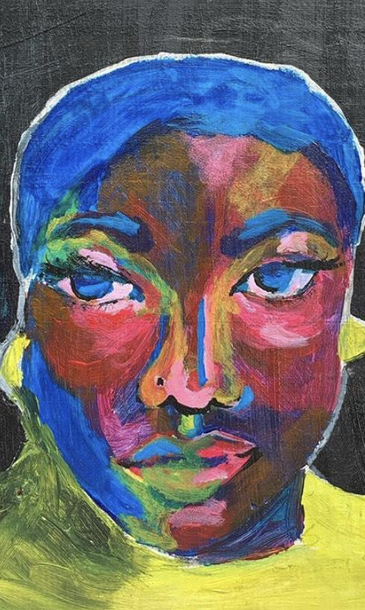
Building Equitable Pathways
BACKGROUND
Bill & Melinda Gates Foundation’s pathways work aims to more effectively support students in navigating key transition points in a student’s education journey through high school, post-secondary, and then into the workforce.
Our goal is to achieve a dramatic increase in the number of Black, Latino, and youth experiencing poverty, ages 14-24, who have the agency, social capital, skills and credentials, and early labor market outcomes needed to thrive in the workforce and life.
Illustration by Ladasia Bryant, age 19

Slide 36
Striving to Thriving
BACKGROUND
A 16-month research project led by Goodwin Simon Strategic Research.
Conducted deep listening research on the impact of young people’s own mindsets on the formation of their occupational identity, work, and life goals
Developed an in-depth psychological and emotional understanding of young people, parents, and other adult influencers
Illustration by Brenda Rivera, age group 15-17

Slide 37
Participants and Methodology
BACKGROUND
Between November 2018 and June 2019 researchers conducted qualitative and quantitative research across the United States. In total researchers conducted 57 focus groups and 7 in-depth interviews at 17 research sites across the United States. They also 2 online asynchronous focus groups and 1 online national survey (n 3545).
The target research population was young Black and Hispanic young people of any income and white young people from households with lower incomes between the ages of 15 and 21. To learn more about young people’s experiences and mindsets we also conducted groups among parents and guardians of our target population and adults who work with or volunteer with our target population.
A full description of the research methodology can be found in the Striving to Thriving report.

Slide 38
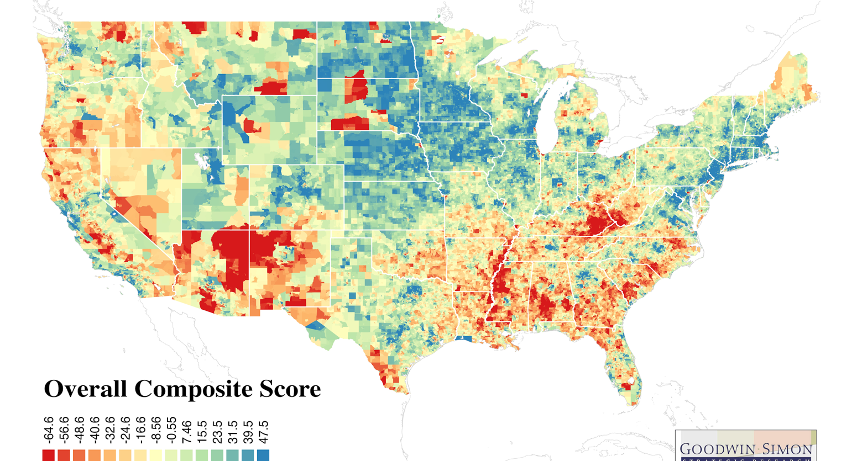
17 Qualitative Research Sites
2018 / 2019
BACKGROUND
Yakima, WA
Winter 2018 In-Depth Interviews
Chicago, IL
Winter 2018/2019 Focus Groups
New York, NY
Pueblo, CO
Gary, IN
Oakland, CA
Baltimore, MD
May 2019 Focus Groups
Albuquerque, NM
Los Angeles, CA
Greenville, MS
June 2019 Intervention Focus Groups
Atlanta, GA
New Orleans, LA
Belle Glade, FL

Slide 39
Research Partners
PARTNERS
PARTNERS
Building Equitable Pathways, Bill & Melinda Gates Foundation’s pathways work aims to more effectively support students in navigating key transition points in a student’s education journey through high school, post-secondary, and then into the workforce. Our goal is to achieve a dramatic increase in the number of Black, Latinx, and youth experiencing poverty, ages 14-24, who have the agency, social capital, skills and credentials, and early labor market outcomes needed to thrive in the workforce and life.
Goodwin Simon Strategic Research is a national public opinion research firm with special expertise in conducting research on emotionally complex, socially sensitive issues. Their unique methodology is used to unpack underlying attitudes and emotional reactions that impact behavior and decision-making and to develop effective message frameworks that enable deep attitudinal change.
Wonder: Strategies for Good is leading work to disseminate the findings from the research led by GSSR and to build a field of practice around these learnings. At Wonder, we’re experts in messaging, storytelling, psychology, and opinion research. We believe curiosity and smart research create amazing, breakthrough moments to make the world a better place. We also understand that human beings are heartwired — that emotions, identity, values, beliefs, and lived experiences shape our decisions on complex social issues — and use that knowledge to help our partners create social change.

Slide 40
Advisory Team: Research
PARTNERS
Romero Brown, Principal, Romero Brown Consulting Nate Cadena, COO, Denver Scholarship Foundation Mary Gatta, PhD, Associate Professor of Sociology, CUNY-Stella and Charles Guttman Community College Noel Ginsburg, Founder and CEO, CareerWise Colorado Mike Lee, Director of Programs, Destiny Arts Center Jane Margolis, EdD, Senior Researcher, UCLA Graduate School of Education and Information Studies | Brandon Nicholson, PhD, Founding Executive Director, The Hidden Genius Project Andrea M. O’Neal, Senior Coach, Career Prep Program, Management Leadership for Tomorrow Roz Pierson, PhD, Partner, Luminas LLC Melissa Risteff, CEO and Co-Founder, Couragion Ayele Shakur, CEO, BUILD Nathaniel Smith, Founder and Chief Equity Officer, Partnership for Southern Equity

Slide 41
Advisory Team: Research Activation
PARTNERS
Austin Estes, Senior Policy Associate, Advance CTE Ayana Gabriel, Senior Program Officer, Arthur M. Blank Family Foundation Carmen Ross, Program Manager, Impact Strategy, Sacramento Region Community Foundation Charline Alexandre-Joseph, Director of Workforce Development, Mentor: The National Mentoring Partnership Eshauna Smith, CEO, Urban Alliance Francisca Angulo-Olaiz, Vice President, Community Engagement, Mile High United Way | Mike Lee*, Director of Programs, Destiny Arts Center Nate Cadena*, Chief Operating Officer, Denver Scholarship Foundation Roz Pierson*, PhD, Partner, Luminas LLC Ruben Harris, Chief Executive Officer, Career Karma Veronica Herrero, Vice President Strategy, City College of Chicago Yalda Uhls, Founder, Center for Scholars and Storytelling at UCLA Yutaka Tamura, Executive Director, nXu
*Denotes those who served on the research advisory team

Slide 42
Striving to Thriving
Core Concepts in a Modular Deck
For more
information visit
Toolkit:
Designing Pathways with Young People

